Slide 1


Build reliable data pipelines using Modern Data Stack in the cloud
Michał Rudko
Data Architect / Technical Product Owner
Jakub Szafran
Data Engineer
Szczecin, 11th July 2023
Notes:
Hi and welcome

Slide 2
Readiness
check
Checklist:
Chrome browser (recommended)
GitLab license for https://gitlab-frontend.home.net.pl/
Access to ext-prj-getindev GCP project and raw-data dataset in ext-prj-getindev project in BigQuery
Access to workshop’s MS Teams channel (HDP - budowa pipeline)
Homework done
Today’s exercises: https://gitlab-frontend.home.net.pl/getindataworkshops/hdp-workshop-materials
Notes:
Prerequisites:
Web browser
Google account
Gitlab account - can be created with google, but password needs to be added manually
Send gmail addres to Andrzej
You will be invited to gitlab group and Slack channel

Slide 3
Today’s agenda
Session 1 - Introduction to Modern Data Stack
What is Modern Data Stack? Intro
Key components of MDS
Core concepts of dbt
Hands-on exercises
Session 2 - Simple end-do-end data pipeline
Transforming data using SQL with dbt
Data testing using dbt
Hands-on exercises
Session 3 - data pipeline scheduling, deployment, advanced dbt concepts
Productionalization of dbt models
Data Catalog
Advanced concepts of dbt
Connecting to BI Tool: Looker Studio
Hands-on exercises
Today’s schedule
09:00 - 10:30 - Session 1
11:00 - 12:30 - Session 2
13:30 - 15:00 - Session 3
15:30 - 17:00 - Session 4 (Q&A)
Lunch Break: 12:30 - 13:30
Notes:
Todays schedule
3 sessions
Each ending / or having hands on coding exercises
Launch break at ca. 12:00 im not really sure lol

Slide 4
Key takeaways
After this workshop you should…
Know what Modern Data Stack is about
Have a hands-on experience with transforming data in dbt
Learn how to orchestrate your data pipelines using best engineering practices without IT dependencies
Know how to use modern data catalogs to search and explore the data
Be able to prevent data quality issues by data testing & monitoring
Notes:
Just read this one
For warmup - ask who is in the room? Dengs, Aengs, Danalyst? etc

Slide 5
Agenda
Session 1 - Introduction to Modern Data Stack
What is Modern Data Stack? Intro
Key components of MDS
Core concepts of dbt
Hands-on exercises: creating your own workspace
Notes:
Session 1
General talk about what we understand as modern data stack
Show key components of our MDP
Talk about general concepts of dbt
During hands on: create working environment: notebook, where we write our code and dbt project, where the code is used

Slide 6
What is modern data stack?
Saves time, effort, and money
Shift from once-off analytics to operational BI and AI
Business (not IT) focused operating model
Airbyte, dbt, Snowflake, Looker, etc.
Data governance as a first-class citizen
Modern Data Stack (MDS) is a set of tools hosted in the cloud that enables an organization for highly efficient data integration (...)
MDS creates clean, trustworthy, and always available data that can empower business users to make self-service discoveries, enabling a truly data-driven culture.
Source: neptune.ai
Cloud based, flexible & scalable, plug-and-play, no long term commitments
Notes:
Lets make sure we are all on the same page on what MDP means
This is going to be a bit business-ish but i think its necessary to mention
Read definition

Slide 7


Data platform challenges
Outdated data docs
Costly licensing
No flexibility
Sounds familiar?
Too much engineering
Vendor lock-in
Chaotic project structures
Long time-to-value
Unreliable data
Notes:
Let’s have a closer look at the key pain points of traditional data platforms that Modern Data Stack addresses
Too much engineering - data driven decisions involve a lot of data engineering & IT support
Long time to value - data insights not arriving in time
Unreliable data - due to lack of data testing, quality checks and data monitoring - discourages from making data driven decisions
Outdated data docs - onboarding new people to data teams is costly and time consuming due to inconsistent & outdated data documentation
Chaotic project structures - due to lack of standardization “the wheel is very often being reinvented”
Costly licensing - long-term commitments, costly licencing fees of traditional stack
Vendor lock-in - not being able to address changing market conditions
No flexibility - data platforms do not scale with the business and are unable to react to changing market conditions
If these sounds familiar to you, then you would like to put more attention to the concept of modern data stack

Slide 8

The Modern Data Platform manifest (needs)
Self-service!
Trusted & documented data!
Project templates!
Low-code transforms!
All-in-one workbench!
Adaptable!
Data access security!
Simple to set up & use!
We need to change the way we think about data platform…
Notes:
Now let’s imagine something that could be a modern data platform manifest - what people actually need.
We dont have much time to elaborate on this, but i’d really like to point out some of the key topics here:
The rest is also important but those I will mention right now we will try to cover in more details today.
Self-service be available and inclusive for all users - everyone from business users to product managers is an analyst and shouldn’t need a data guy to understand company’s data
Low-code transforms allow analysts to do their job - don’t force them to write complex transformations
Trusted data! - provide context associated with data, , in practice this means the platform should be able to gather data descriptions, history and lineage in one place - single source of truth that can be easily maintained via code repositories.
All-in-one workbench - self explanatory, one tool to rule them all
So, we had challenges, we have needs…
More and more organizations have been sharing the same feelings how modern data platform should look like…
Self-service! - be available and inclusive for all users - everyone from business users to product managers is an analyst and shouldn’t need a data guy to understand company’s data
Low-code transforms! - allow analysts to do their job - don’t force them to write complex transformations
Trusted data! - provide context associated with data, allow users to foster trust in the data and encourage collaboration - in order to make well informed data-driven decisions. Gather data descriptions, history and lineage in one place - single source of truth that can be easily maintained via code repositories. Allow users to easily discover and analyze data within the platform - no more human bottlenecks and chaotic, inconsistent documentation
All-in-one workbench! - single place with single sign-on for all the tools needed for the job
Data access security! - employing industry best practices and cloud vendors’ configuration for data access management. Treat data governance as a first-class citizen not an afterthought anymore
Project templates! - enables grouping and reusing similar projects concepts
Adaptable! - be scalable and quickly adapt to changing business requirements. Have loosely coupled components - an easy process to replace one component with an alternative. Allow easy rollback without long term and costly commitments.
Simple to set up & use! — no lengthy sales process, demo calls, and implementation cycles. Our solution is built on open standards & APIs allowing easy integration with the rest of the stack so vendor lock-in is not a risk. It’s also easily maintainable without a large specialized IT team - analytics engineers are equipped with a toolset that allows easy debugging of their pipelines

Slide 9

Why is MDP possible? (enablers)
Cloud DWH
(e.g. BigQuery)
Low-code transformation tools (e.g. dbt)
Data integration frameworks
(e.g. Airbyte)
Architecture, data security & engineering best practices
Modern data catalogs
(e.g. Data Hub)
Self-serve BI tools (e.g. Looker)
The technology is already here!
Notes:
Now it is time to consider why we are talking about modern data platforms these days And this is also thanks to the technology.
Cloud DWH that offer flexibility for scalable storage and computing
Low-code data transformation tools (like dbt) - all data transformations in SQL
Data integration frameworks - featuring many built-in connectors supporting extraction & load of the data
Modern data catalogs - data discovery has never been easier!
Self-serve BI tools - data modelling & visualization capabitilies
The technology is already available… All you need to do is just to connect the dots and use it wisely using architecture & engineering best practices.
- evergreen standards translated into data processing world.

Slide 10
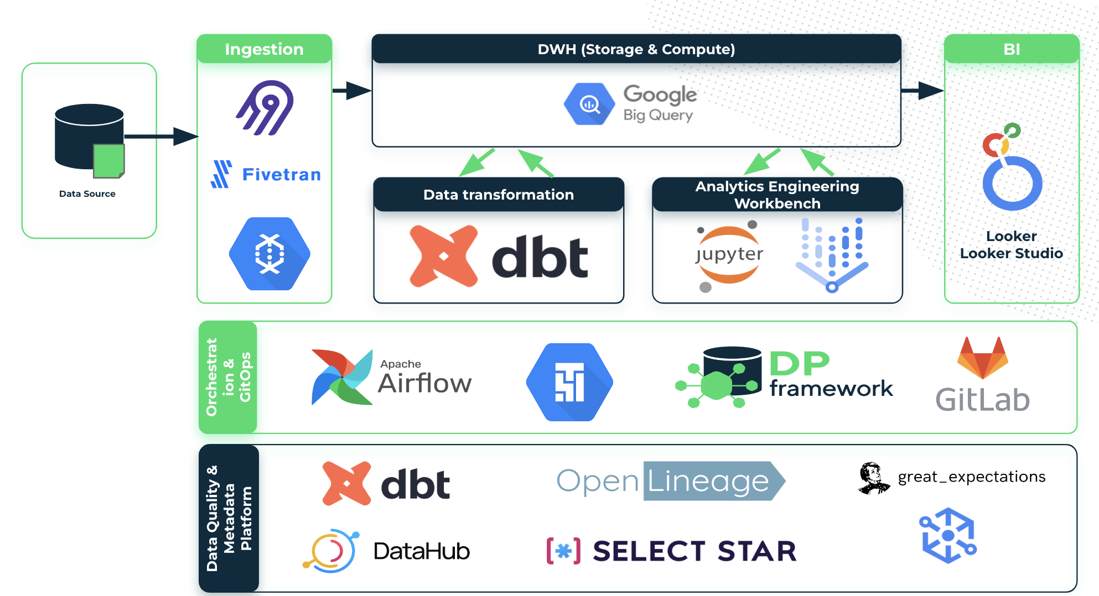
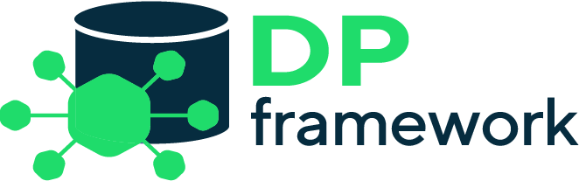
GetInData Modern Data Platform -
our blueprint (GCP example)
Solution optimized for:
any cloud / on-premise
flexibility & extensibility
self-service
data mesh readiness
modularity
automation
observability & discovery
data-pipelines-cli
dbt-airflow-factory
Project Template Factory
Notes:
So this is where our MDP comes and shines
GID MDP have all of those parts I mentioned seconds ago
And During this workshops the MDP instance is running and we will use it to practice dbt, and see other cool things
Our MDP is not a product, some day, it might be
It is quite well developed proving ground for ideas, PoCs, tests etc.
Some of those were implemented in commercial projects as production code
Some are taken from external projects for further development

Slide 11















GetInData Modern Data Platform -
the framework and its components
Ingestion
DWH (Storage & Compute)
BI
Data Source
Data transformation
Analytics Engineering Workbench
Looker
Looker Studio
Orchestration & GitOps
Data Quality, Observability & Metadata Management
Dataplex
Notes:
So, let’s quickly go one by one
First: DBT: it’s a data transformation framework, for data analyst, engineer or analytics engineer it is a center point of the platform, he will spend 90 % of his time managing dbt pipelines
Then, there is his workspace.
MDP runs on cloud, so it is the workbench we will use to create project, write code and so on.
In MDP we used VertexAI and its managed JupyterLAB notebooks.
The user creates his own notebook by providing the preconfigured JupterLab image.
This image is created by devops and includes all installations, tools and libraries used by MDP
Next, we have Data Warehouse - in our case it is Google Bigquery
Btw. VertexAI is also by Google
But the idea is that MDP itself is cloud agnostic, we have examples of running this MDP with Snowflake
As a data ingestion tool we chose Airbyte.
Open source
User Friendly
Developer Friendly
Active community
We will not use it today but if someone’s interested I can show UI
Next, we have BI Tools for analysis and reporting.
Looker Studio - free, part of Bigquery
Looker - paid, expensive but it is an analytics platform itself, very powerful
For pipelines scheduling we use instances of Airflow that run on Google Composer Service
Airflow takes whatever dbt creates and converts it to DAG
Execution of DAGs creates our production tables
For code management, version control and CICD - we use Gitlab
In Gitlab we create our dbt projects
And we have important thing - DP Framework
This is this Engineering part of the MDP, its a set of libraries that allow to automatically orchestrate all of these tools, including data catalog
Orchestration setup is included in dbt project as additional configuration files - > user does not interfere with those
The config is created with templates
DP framework has been written by GID and it is open source, everyone can benefit from it, or contribute to
And last but not least - data catalog
Powerful tool for bringing all information about our data to one place
This means documentation, definitions, glossary, categorized metadata and so on - important aspects of data governance
In our MDP we choose datahub
Like Airbyte - its is open source, has rich and active community, constantly evolving

Slide 12
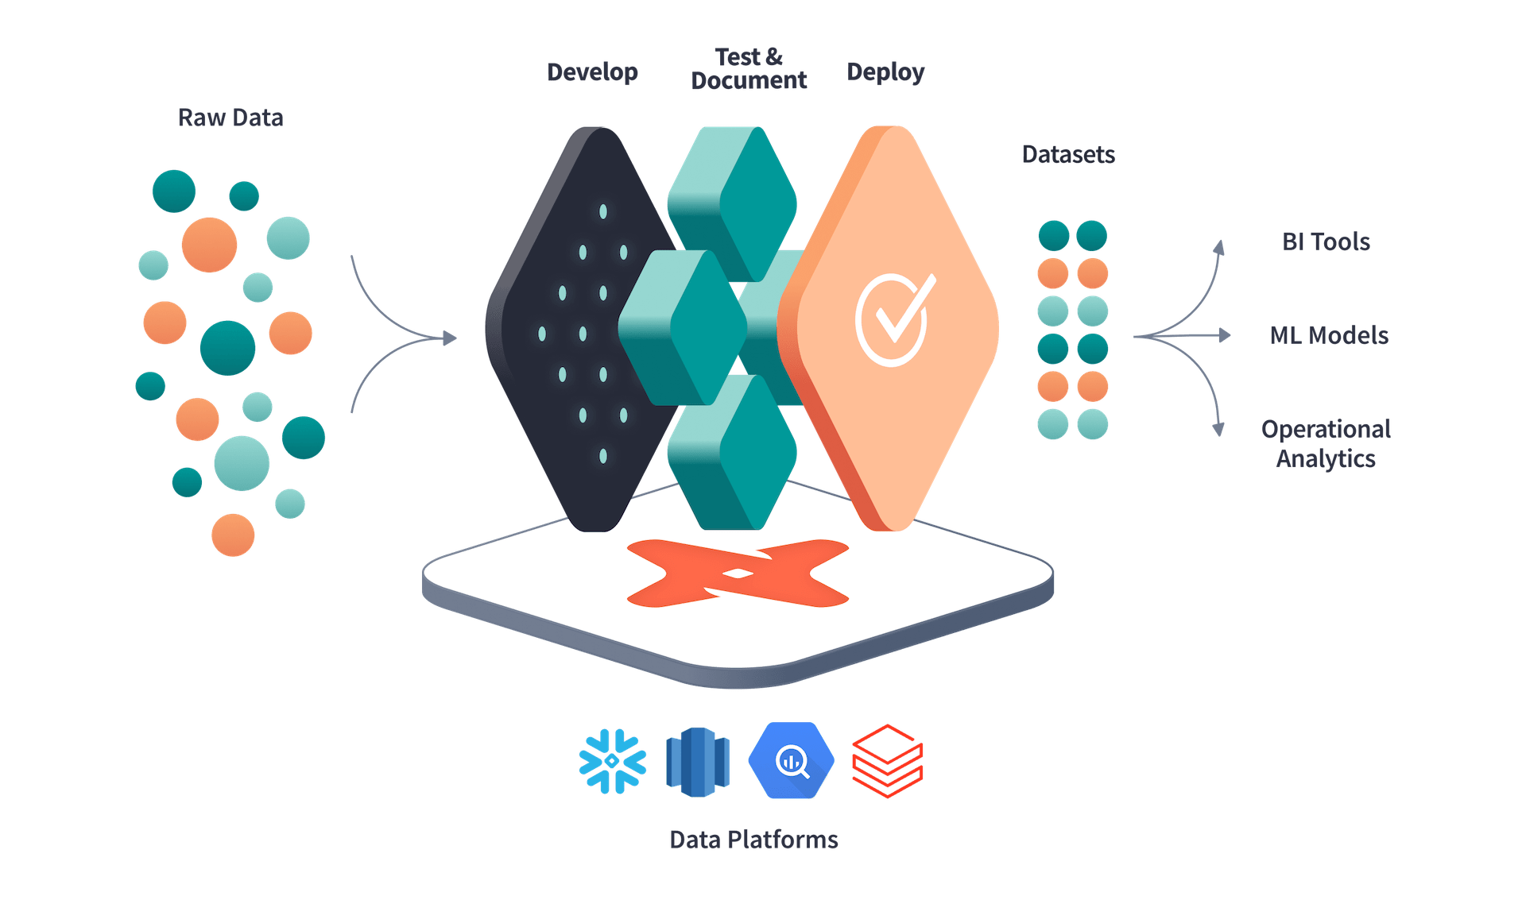
Core concepts of dbt
“dbt™ is a transformation workflow that lets teams quickly and collaboratively deploy analytics code following software engineering best practices like modularity, portability, CI/CD, and documentation. Now anyone who knows SQL can build production-grade data pipelines.”
getdbt.com
Source: getdbt.com
Notes:
Ok, now, let’s proceed to the main object of interested for today - dbt.
I will read this business definition by dbt-labs, the creators. But honestly, this is all true.
Read the slide

Slide 13
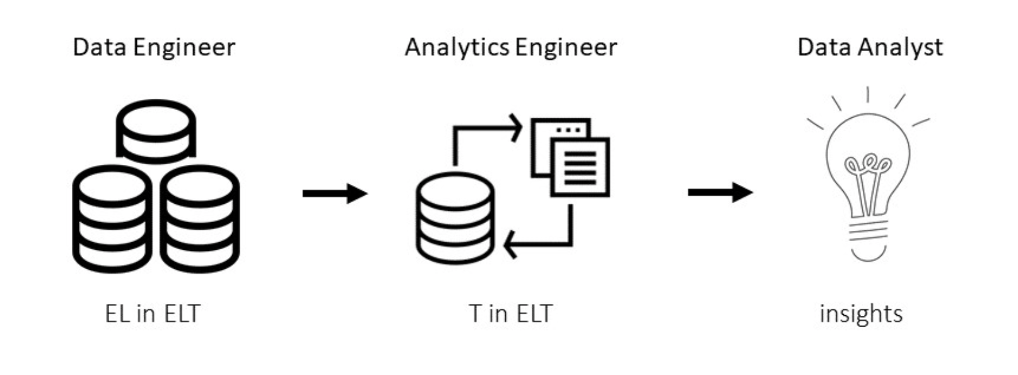
Core concepts of dbt
What problem does dbt solve?
Provides software engineering-grade way of writing data analysis code
Compiler & runner
Automated testing
documentation
project structuring
resolving dependencies
environments configuration
SQL
Python
(recently)
Notes:
A command line interface and development framework
You can treat it as a compiler and runner
It allows to perform automated testing
Comes with its own documentation generator, very useful
Allows for logical and convenient dwh schema structurizing
Allows for many environments config

Slide 14
Core concepts of dbt
SQL
select *
from table_A
where column_B > 0
jinja
{{ function( ‘var1’, ‘var2’, …. ) }}
{{ config (‘....’) }}
CLI
C:\project\dbt run – select my_model.sql
C:\project\dbt compile
Notes:
DBT user / pipeline developer
you will need to be proficient with SQL in order to write dbt models
Command line interface to be able to execute them
You will need to know some functions written in jinja that were implemented dbt to be able to write efficient pipelines

Slide 15
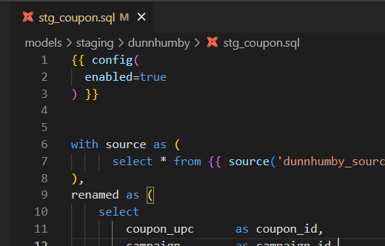
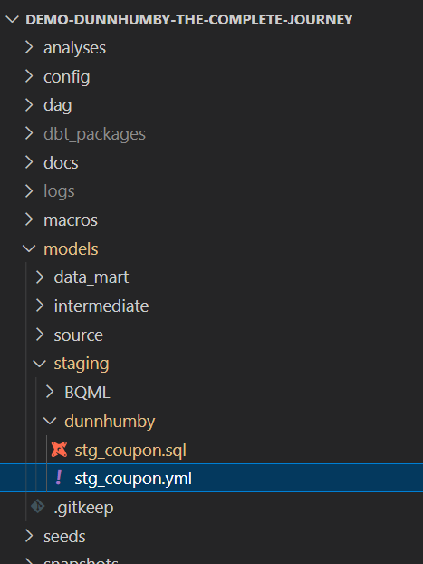
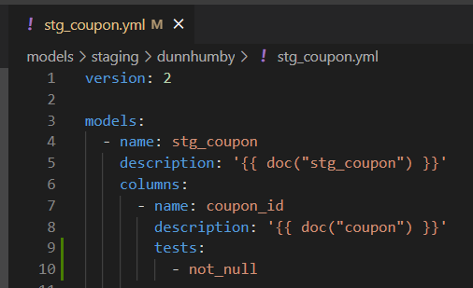
Core concepts of dbt
dbt model
Select statement
SQL file
YML file
metaconfig
Notes:
DBT fundamental concept is a dbt model.
Technically model is a set of two files:
SQL file with the SQL code inside
And additional metaconfig YAML file, storing all additional metadata and procedures
But in general a dbt model is a SELECT statement that performs data transformation.
Which is important, SQL file is a must have!
But you can skip metaconfig and leave everything on default.

Slide 16
Core concepts of dbt
Create models, calculate dependencies
{{ source( “schema”, “table” ) }}
{{ ref( “dbt_model” ) }}
table_A.sql:
select *
from {{ source( “my_schema”, “raw_table” ) }}
table_B.sql:
select *
from {{ ref( “table_A” ) }}
raw_table
Notes:
Ok, So second general concept of DBT is calculating dependencies between models
How DBT does that?
Two general, most used and most important dbt JINJA functions: SOURCE and REF
The source function tells dbt, the model will be referencing to the tables in data warehouse that already exist
Those tables were not created within dbt and will not be ever modified by it
So these are source tables, raw data
Then, there is the ref function
In opposition to source - it refers to a dbt entity

Slide 17
Core concepts of dbt
Create models, calculate dependencies
{{ source( “schema”, “table” ) }} compiled
{{ ref( “dbt_model” ) }} compiled
create or replace table_A as (
select *
from “my_schema.raw_table”
)
create or replace table table_B as (
select *
from “my_schema.table_A”
)
raw_table
table_A
table_B
Lineage

Slide 18
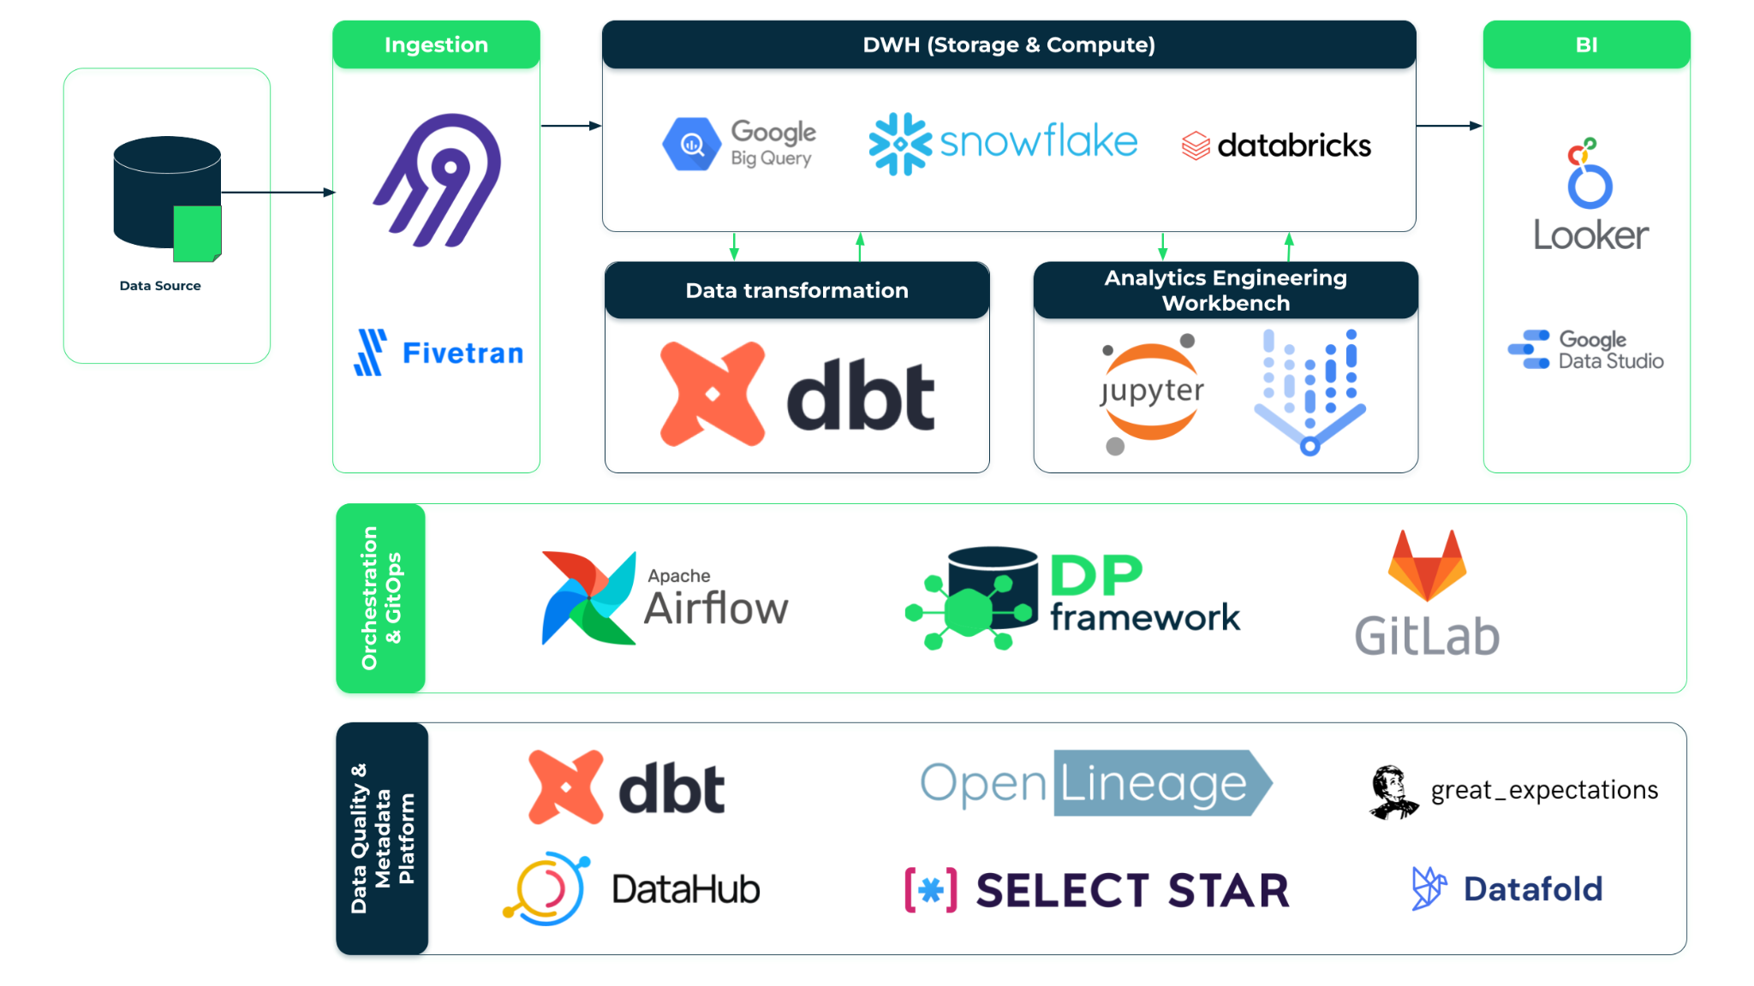
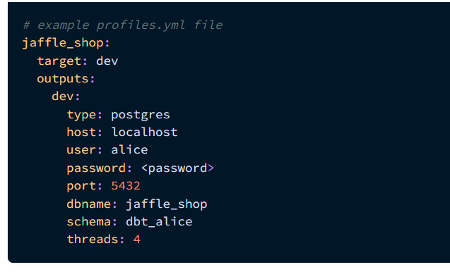
Core concepts of dbt
Connection to DWH, different environments
~/.dbt/profiles.yml
Project name
Environment
Config (dev, local, prod…)
DWH type
Address
Credentials
DB name
Default working schema
Number of threads
In Modern Data Platform:
dbt instance is installed and configured
config is stored as a part of DP framework
DWH access is granted through user’s notebook
However! User should be aware what database name or GCP project-id his dbt project will use
Notes:
How does dbt know where to find tables, schemas and data warehouse?
We need to tell him that by editing a profiles.yml config
The config is stored by default in dbt installation root folder
We specify config for every distinct project
Define default execution environment
Define execution environment config
Type of DB
Address
Access credentials
Name of database
Name of schema
Threads
MDP does configuration automatically within DP Framework
Access to DWH is granted through GCP account
User at least needs to know where is his data stored at time where he creates his project

Slide 19
Core concepts of dbt
Hands-on:
Create your workspace
Your workbench (JupyterLab based)
GitLab project
Create and initialize dbt data transformation project
Inspect data in BigQuery
… coffee break
Notes:
Now ill show how to create your personal workspace in the cloud using our platform
And then we will make frist steps into dbt

Slide 20
Session 2 starts at 11:00

Slide 21
Agenda
Session 2 - Simple end-to-end data pipeline
Transforming data using SQL with dbt
Data testing using dbt
Hands-on exercises
Notes:
Session 1 is about core concepts of modern data stack and one of its main components - which is dbt. We will cover some fundamentals here.

Slide 22
Transforming data with dbt
SQL = model is executed with dbt run command (CLI). While executing it, dbt will materialize an entity in your data warehouse. You can choose whether you want a view, table, ephemeral object*, incremental table or snapshot.
Execute SQL
dbt run
For better transparency and future debugging use Common Table Expressions
Write SQL
Automated tests
dbt CORE = an open source CLI tool
Text Editor / IDE
dbt test
Almost everything in dbt is a SELECT statement. As an analytics engineer / data analyst you focus on business logic. Following some internal dbt rules and good practices will cause your SQL to become a dbt model.
Test is an assertion about your model and it is also a SELECT statement. Use as much test types as you can think of. This will greatly improve a trust in data you serve to your team & stakeholders.
Validation & Deployment
docs + SQL
deployment pipeline
Notes:
Dbt workflow
Using text editor or IDE we write a SELECT statement
Then the model, or a pipeline made by many models is executed
dbt run with its variations and clauses
Write and trigger tests after pipeline execution
We write documentation (very rich docs generator)
Publish or deploy the SQL pipeline to dev / prod
And the circle ends

Slide 23
Transforming data with dbt
Sources: define your input data
dbt model
vs
dbt source
In dbt sources refer to tables that already exist in data warehouse
If data in the source table changes - it is not a result of a dbt transformation
dbt sources are defined in yaml file / files alone
Sources are referenced by using the source function
You can put tests and documentation on dbt sources
Select statement
SQL file
YML file
metaconfig
YML file
metaconfig
Notes:
So, we talked about SOURCE and REF functions
This is connected to the concept of dbt sources
Dbt source is NOT a model
It needs to be defined as a separate entity in dbt
Only YAML
We can put tests ad documentation on sources

Slide 24
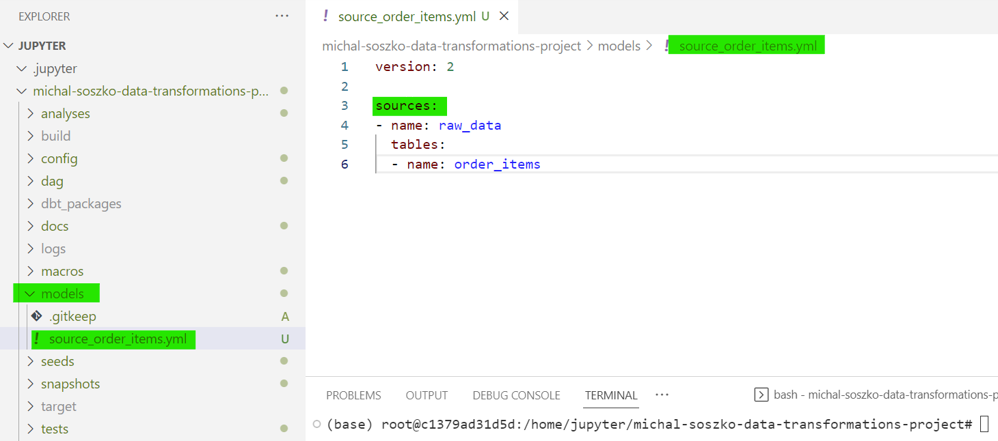
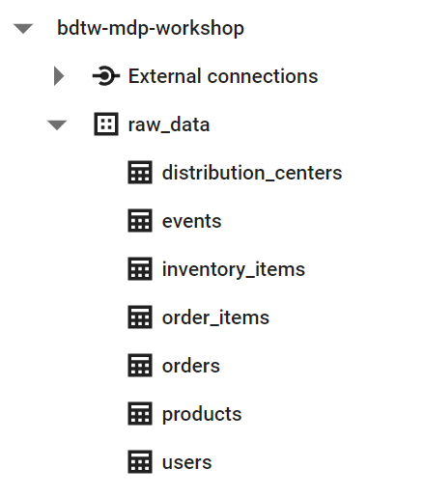
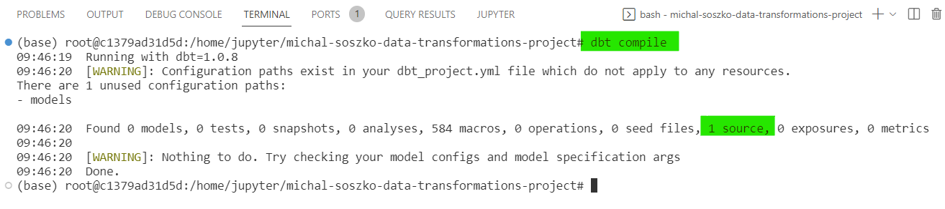
Transforming data with dbt
Sources: define your input data
Notes:
So this is how it looks

Slide 25
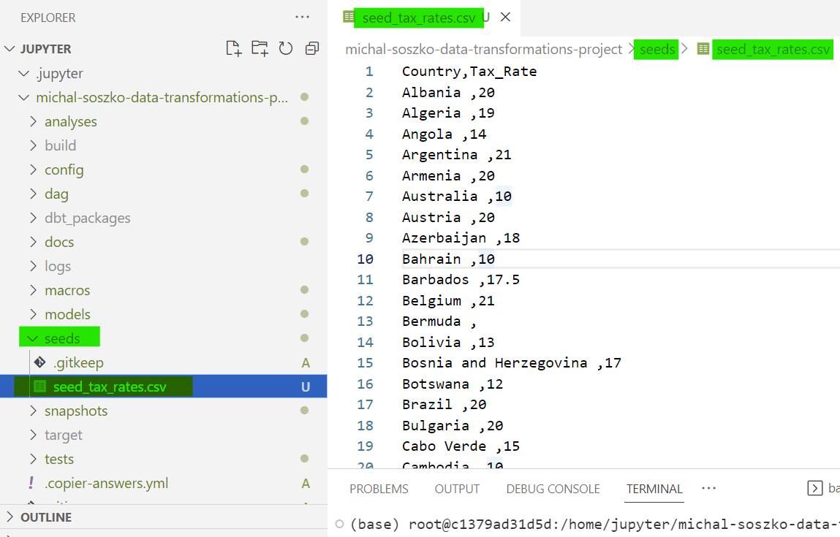
Transforming data with dbt
Seeds: add custom CSV data to your project
In dbt, seeds are small CSV files you can add to your project
Put your CSV file into seeds folder
Run command dbt seed to ingest the file as a table into the DWH
You can add meta-config yaml file to your seed
Seeds are referenced by using the ref function
Notes:
Before we go to models there is one thing worth talking about
Sometimes we need to use small chunks of data,
Like for example, someone sends us a small CSV, couple of hundreds of rows table with some mapping between some columns
In that case we could directly upload that table in DWH and make it a source for our dbt models
Or make it a part of dbt by storing this CSV in our project
When we put this CSV in a seeds folder the file becomes a seed
In the example above we add table with tax rates for countries

Slide 26
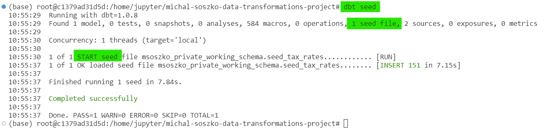
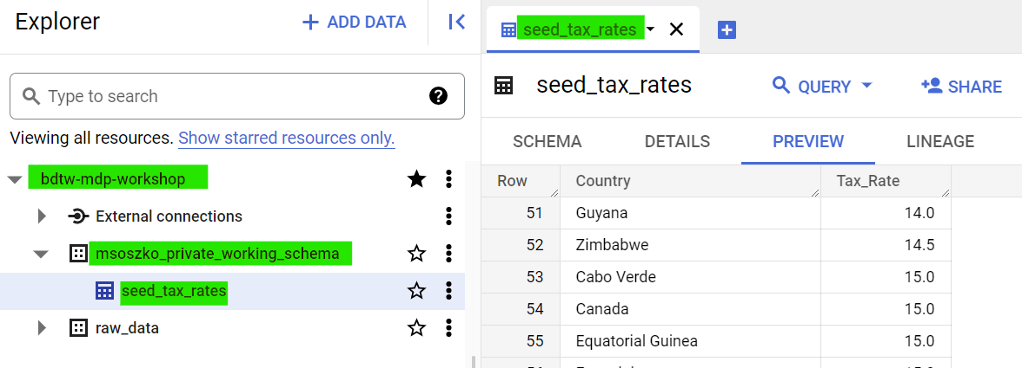
Transforming data with dbt
Seeds: add custom CSV data to your project
To run a seed type:
dbt seed
dbt seed --select seed_file
Notes:
And by using the dbt seed command, the dbt will put it into dwh by itself
We can add yaml metaconfig for seed files
We can test it
And reference it downstream using REF jinja function

Slide 27
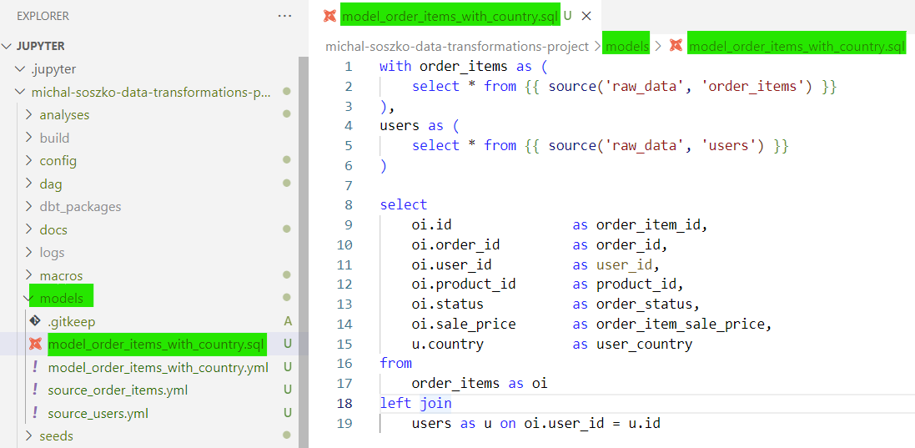
Transforming data with dbt
Models: foundation of a dbt data pipeline
Model is a select statement stored in a SQL file.
Model metaconfig yml file is optional
Executing a model with the dbt run command will create a table / view in the DWH
Models are referenced within dbt using the ref function
There are different materialization modes to choose from:
table
view
incremental table
ephemeral
Notes:
And finally - the models
Read the slide lol
In the example on the slide, the model is created from two joined sources
New model is called order_items_with_tax and adds country column to otder_items, this will be needed for tax caluclations

Slide 28
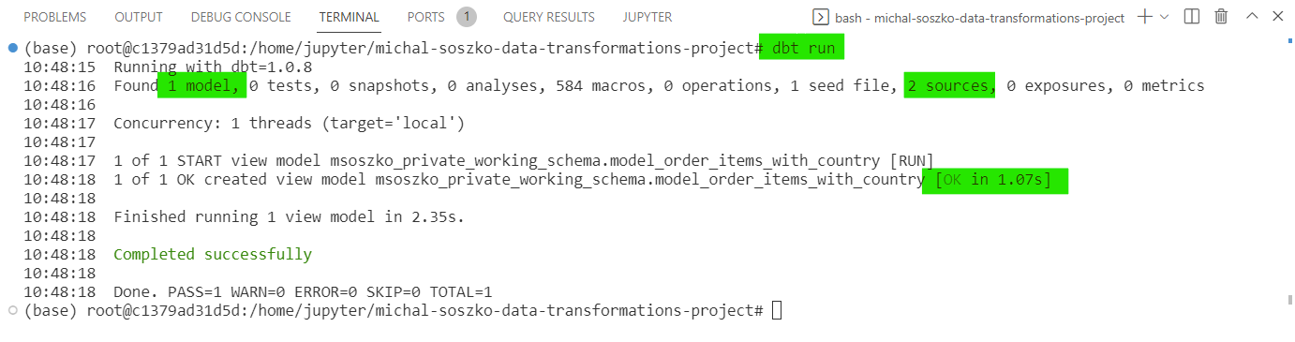
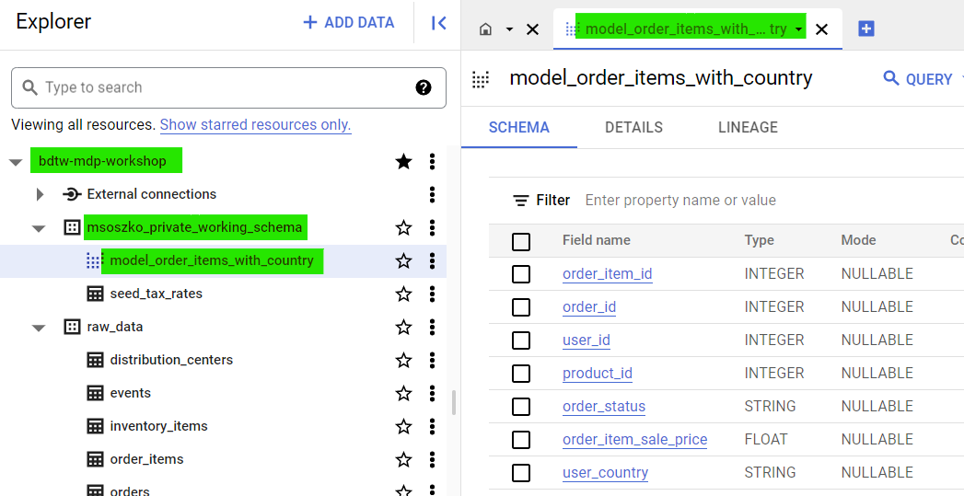
Transforming data with dbt
Models: foundation of a dbt data pipeline
To run a model type:
dbt run
dbt run --select your_model
dbt run --select +your_model+
Notes:
When we trigger dbt run command models are compiled and sent to Bigquery
As a result new table or view materializes in our private working schema

Slide 29
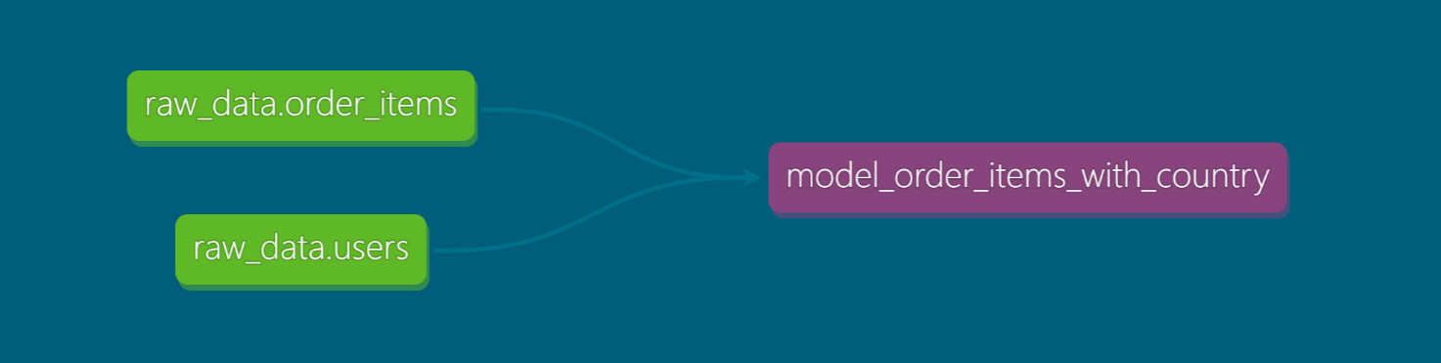
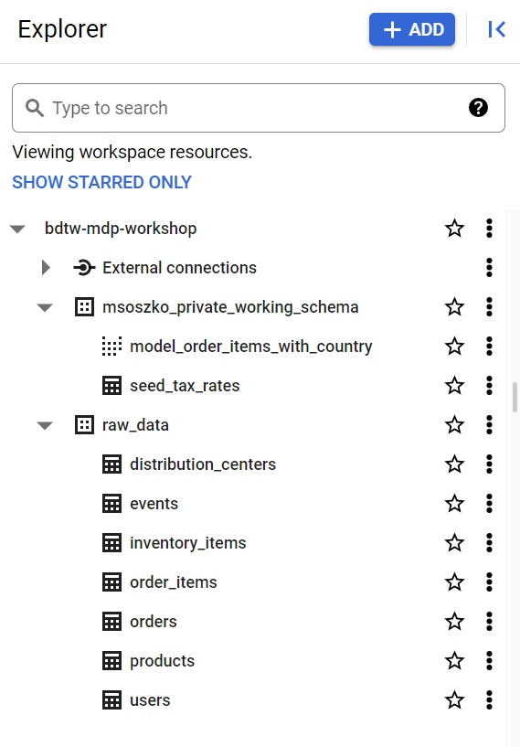
Transforming data with dbt
Models: foundation of a dbt data pipeline
dbt sources
dbt model {{ source ( ‘schema’, ‘table’ ) }}
Notes:
So, that is how it looks, when we inspect a lineage graph
We have two source entities, raw tables
And a model, that is referencing directly those sources and joins them

Slide 30
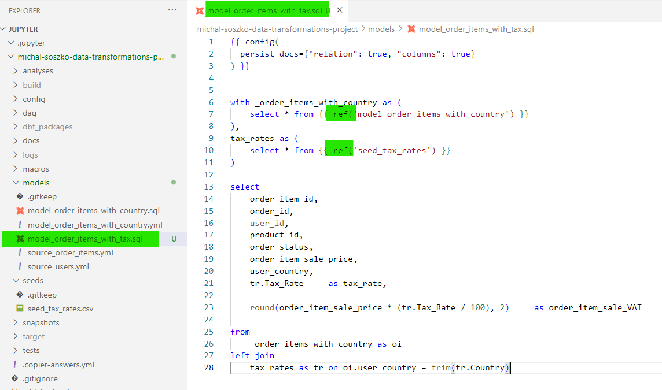
Transforming data with dbt
Models: foundation of a dbt data pipeline
Notes:
Now, if we create new model that takes tax rates and adds them to order_items_with_country
Then it calculates the tax and reports it in new column
This is how it could look like
We are referencing a seed
And referencing our previously created model

Slide 31
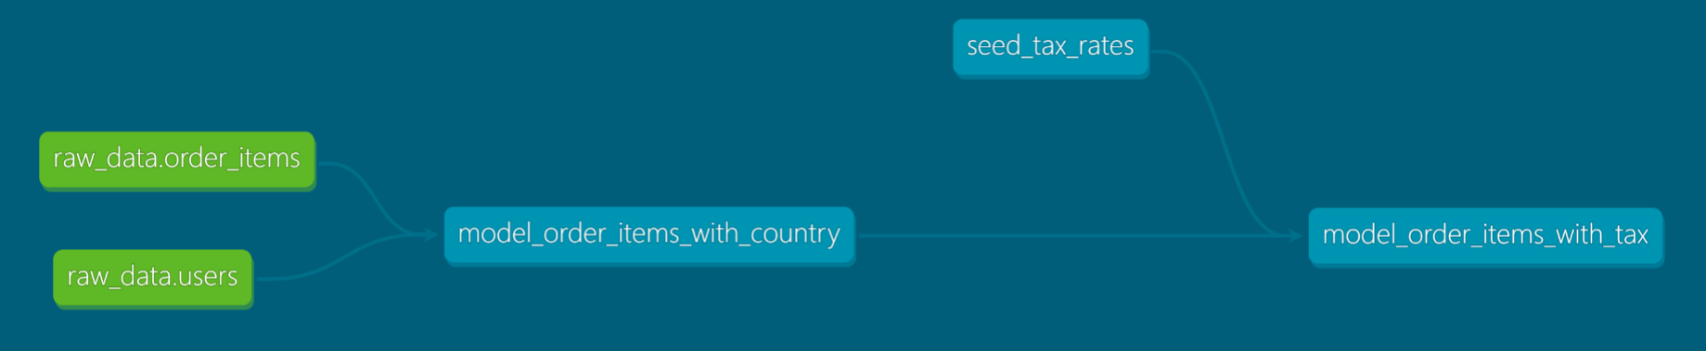
Transforming data with dbt
Models: foundation of a dbt data pipeline
dbt sources
dbt model
referencing sources {{ source ( ‘schema’, ‘table’ ) }}
dbt models
referencing other dbt entities {{ ref( ‘model_name’ ) }}
{{ ref( seed_name) }}
Notes:
And after dbt run, the graph will look like that
There are two new entities - tax rates seed
And our new model taking data from both those entities here
The oversimplified tax calculating pipeline is ready!

Slide 32
Hands-on exercises:
Open Session_2a.md and
…create your local data pipeline!

Slide 33
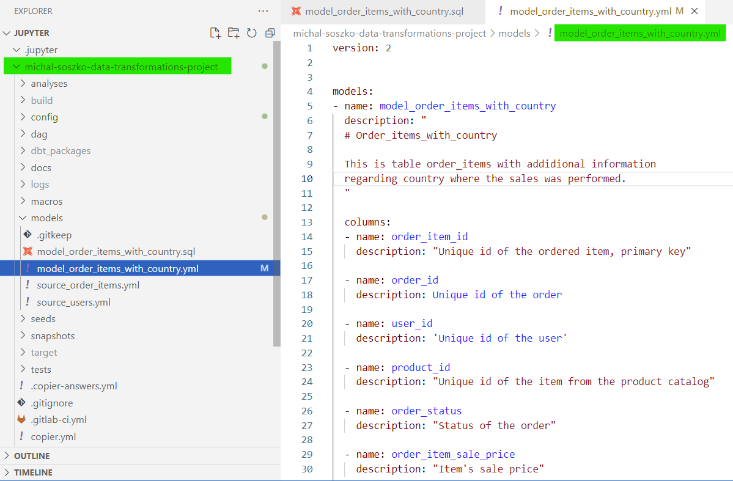
Transforming data with dbt
Models: metaconfig YAML files
Metaconfig YAML file stores descriptive information about the model.
The YAML file is optional
Allows documenting all dbt entities (models, seeds & sources) at their source
Allows adding tests to all dbt entities
Whitespace sensitive!
You can store all model, source and seed metadata in one big yaml file (however, we recommend splitting them to keep the highest granularity - ie. 1 SQL file per 1 YAML)
Notes:
Start the second part of Session 2 with explaining the YAML metaconfig file
For models yaml file is optional but extremely useful
This is an example: yaml file and its corresponding SQL
But also define which generic tests that will be used for our the model

Slide 34
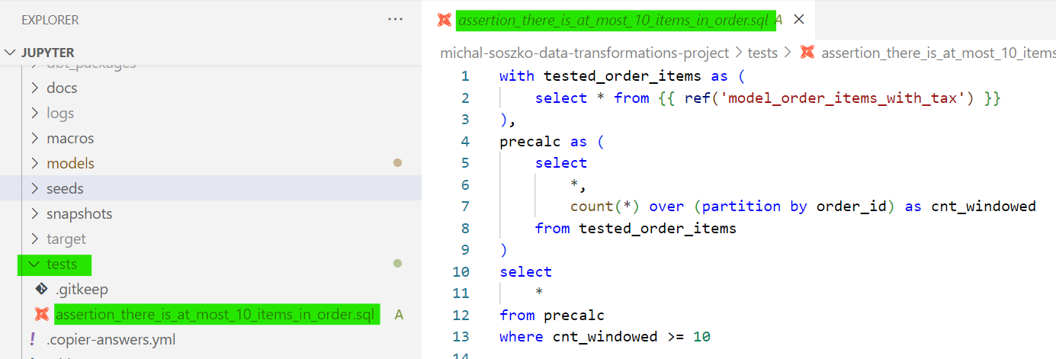
Transforming data with dbt
Data quality in dbt: tests
To run tests type:
dbt test
dbt test --select model
dbt test --select assertion
In dbt test is an assertion about your model
it is a SELECT statement
Test fails whenever at least one record is returned
Test passes whenever no data is returned
There are two types of tests: generic and singular
Notes:
I mentioned tests, what are they
Test is a select statement representing assertion about your model, seed or source
TEST FAILS whenever at lest one record is returned by the query
Test passes wheneve no data is returned
We’ve got two types of test in dbt: generic and singular
This one on the screen is SINGULAR
Tel what singular test is about

Slide 35
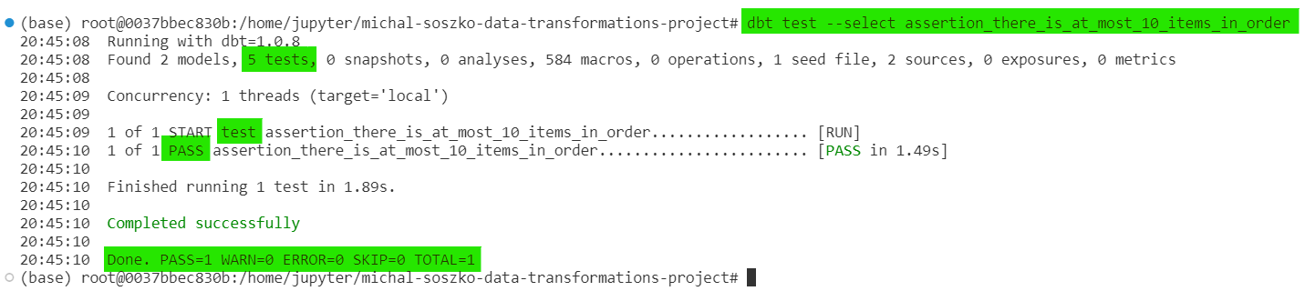
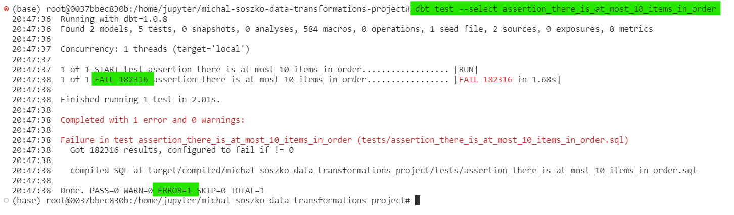
Transforming data with dbt
Data quality in dbt: tests
Success
Failure
Notes:
How the dbt output looks for test that passess
Or fails
Tell what we see on the screen

Slide 36
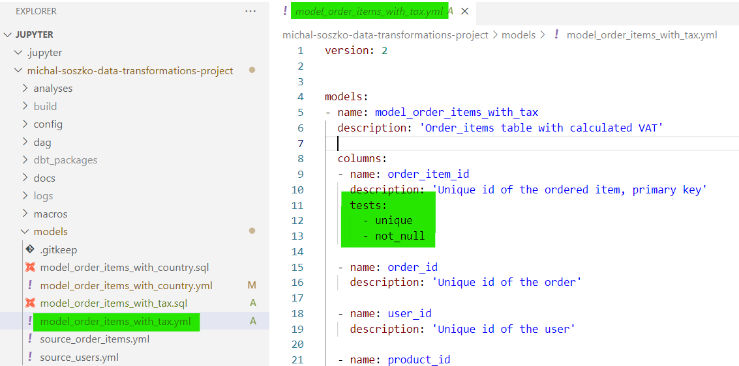
Transforming data with dbt
Data quality in dbt: tests
Generic tests can be applied to any column
There are 4 main generic tests:
not_null
unique
accepted_values
relationships
Users can define their own generic test as jinja macros
dbt community has served hundreds of custom generic tests; you can find them in many public packages:
dbt-labs / dbt_utils
calogica / dbt_expectations
and many more: https://hub.getdbt.com/
Notes:
Next type of test is a generic test
Basically, generic test is a macro that can be applied to any column or table
Dbt comes with 4 butil int generic test which are
Not null
Unique
…
But users can define their own generic tests in form of jinja macros
Dbt has official repository for those kind of things, stored in so called package

Slide 37
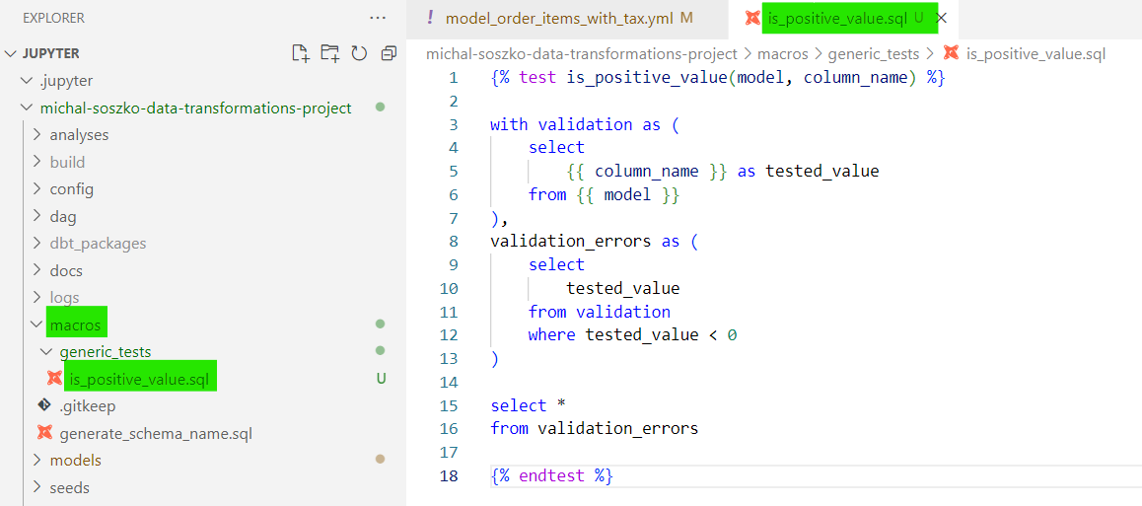
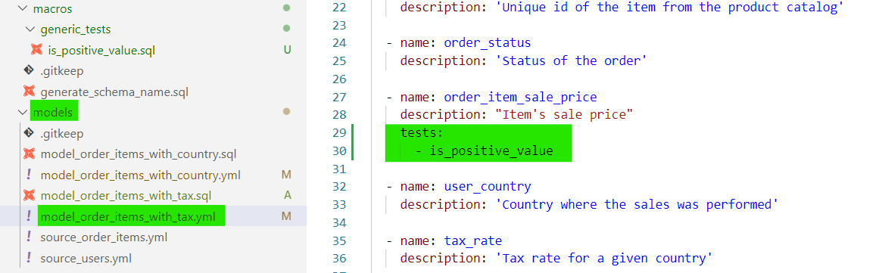
Transforming data with dbt
Data quality in dbt: tests
Generic tests can be applied to any column
There are 4 main generic tests:
not_null
unique
accepted_values
relationships
Users can define their own generic test as jinja macros
dbt community has served hundreds of custom generic tests; you can find them in many public packages:
dbt-labs / dbt_utils
calogica / dbt_expectations
and many more: https://hub.getdbt.com/
Notes:
Here is an example of how the custom generic test looks like
Its a select statement but with jinja-specific additions defining type of the macro and variables
Variables are then referenced in select statements using double brackets
In contrary to singular tests, we dont put those in tests folder but in macros
And by adding proper lines in yaml file we tell dbt this test should be performed on a specific colun
Just like for default generic tests

Slide 38
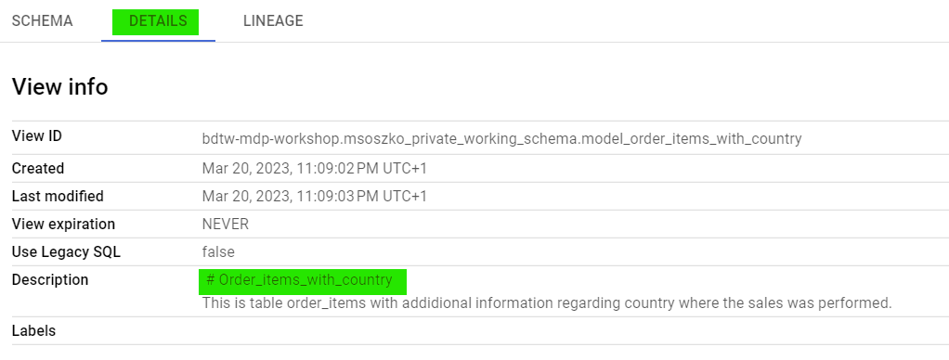
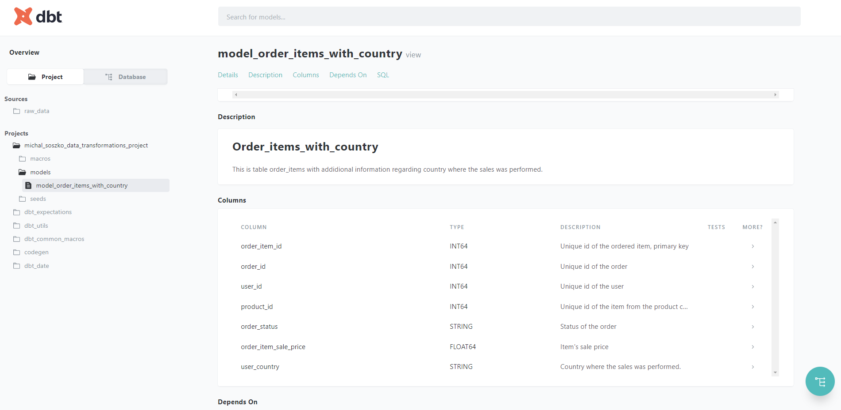
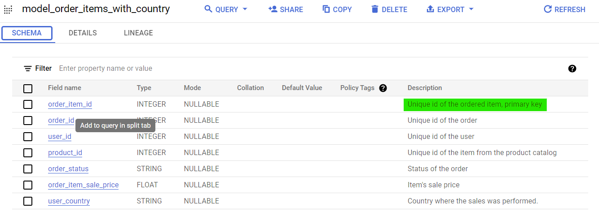
Transforming data with dbt
Documentation and graphical lineage
Notes:
Ok, we’ve got tests covered
Let’s take a look at descriptions
In description fields inside of YAML file we can use markdown formatting
As well as just ordinary text.
This is how dbt project documentation generated by dbt looks like
Anything we pass to those fields here you will find in here
But also this can be parsed to Bigquery as well

Slide 39
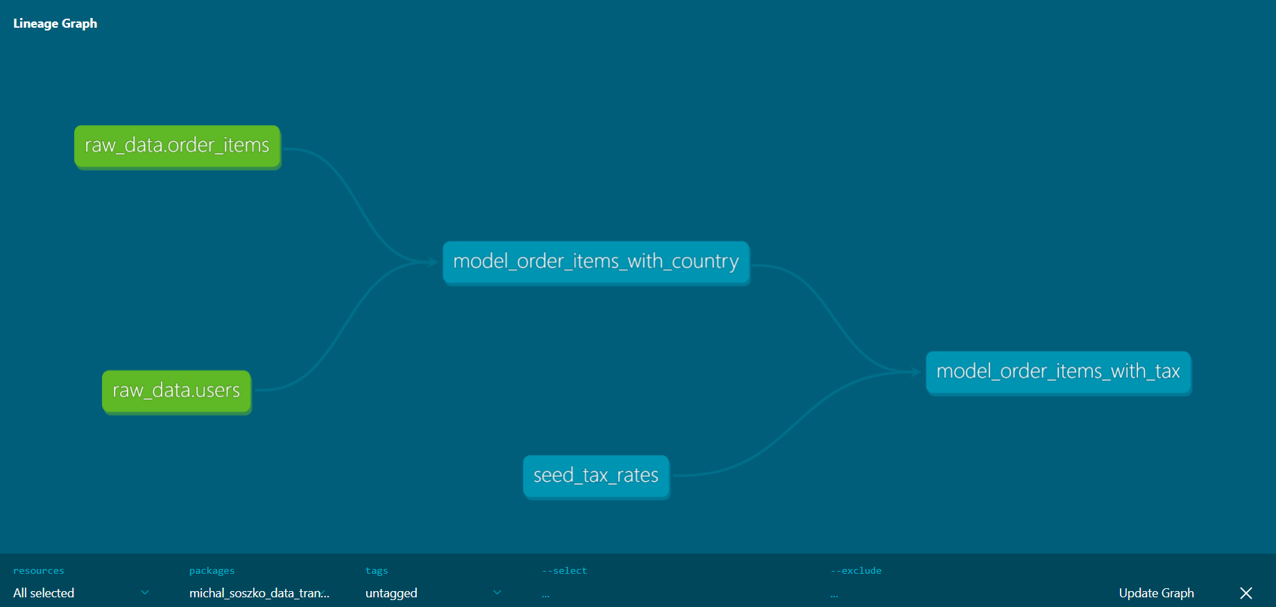
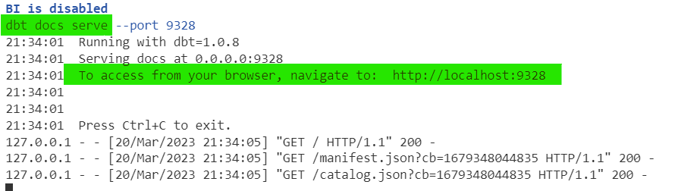
Transforming data with dbt
Documentation and graphical lineage
dbt comes with its own documentation generator
Rendered documentation can be viewed via web-browser
Model and project documentation (table / column level descriptions, project description etc.) is stored as a part of the dbt entity metaconfig YAML file.
In MDP, you can access your local documentation using the dp docs-serve command
In regular dbt-core instance accessing the local documentation requires two commands:
dbt docs generate
dbt docs serve
Notes:
Also, which is powerful, we an preview graphical image of our model dependencies, called DAG or lineage graph
Unfortunately it is only table level lineage, column level has not been implemented in dbt yet
So, dbt comes with its own documentation generateor
DBT hosts it in form of a web page we can also share with others that have no access to dbt projet
In order to create that in dbt we use two commands
But due to some technical limitations in MDP we created own connector for that, and we run it with a command dp docs serve

Slide 40
Transforming data with dbt
Documentation and graphical lineage
dbt docs generate
Modern Data Platform
DP Framework
dp docs-serve
dbt docs serve
Notes:
And to wrap up, its not that we are lazy and want to have one command
It’s just because of some procedures that overlap
But we will skip the details

Slide 41
Lunch Break…!
…and hands-on exercises:
Open Session_2b.md and ensure high quality of your models by adding documentation and tests to your local pipeline!
Notes:
Ok! Let’s put those new information into practice and move to hands-on exercises session 2b.

Slide 42
Session 3 starts at 13:30

Slide 43
Session 3 - Scheduling, deployment, advanced dbt concepts
Productionalization of dbt models
Data Catalog
Advanced concepts of dbt
Connecting to BI Tool: Looker Studio
Hands-on exercises
Notes:
Ok, With presentation of datahub we officially finished session 2
Lets move to tge final part
In session 3 we will talk about how can we transfer dbt project to production environment
Then we will see some advanced concepts related to dbt project structuring and data modeling
Ending with connecting our production models to BI tools

Slide 44
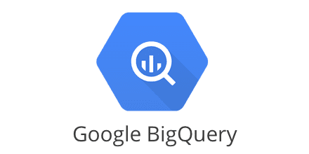
Transferring from local model development to DEV / PROD
User_personal_schema
stg_schema
Intermediate_schema
marts_schema
reports_schema
Local
Jupyter workspace, VSCode, dbt
Git commit & push to remote
Merge Request
Datahub
CICD
Airbyte
Airflow
Notes:
Up for now, we’ve been working using our private notebooks
All models we ran were executed locally and stored in our local personal schema
But since we use gitlab as the version control manager our dbt code, the project, is stored in a repository
Now we can publish our work to remote repository
The push to remote triggers the continuous integration and continuous deployment phase that is carried by Gitlab
Once the dbt code, along with all the additional configs coming from DP Framework reach gitlab, the information stored in this code will be transformed and distributed over other tools that are part of the MDP.
Those are Datahub, Airbyte and Airflow
The dbt manifest is converted to Airflow DAG, and this DAG is then executed by production instance of Airflow
Airflow executes models and stores the resulting tables and views in production schemas in Bigquery

Slide 45
dbt compile & the manifest file
Whenever one runs dbt run or dbt test , dbt compile runs first.
dbt compile parses SQL and YAML files, renders Jinja templates in those, and generates manifest.json file.
dbt uses manifest.json file to decide in what order it should run the models, which one should be materialized as tables and which as views, etc.
{
"metadata": {
"dbt_schema_version": "https://schemas.getdbt.com/dbt/manifest/v5.json",
"dbt_version": "1.4.0",
"generated_at": "2023-03-20T08:51:59.212464Z",
"invocation_id": "9ae5f35d-d9a0-4f71-9136-0bfc52128bea",
"env": {},
"project_id": "cf6ef8b0d94b1214ee1c83dc66bb4eb5",
"user_id": "19c06c51-fdaf-4be6-95fa-6d3724afa750",
"send_anonymous_usage_stats": true,
"adapter_type": "bigquery"
},
"nodes": {
"model.example_schema.users_basic_info": { ... },
"test.example_schema.unique_users_basic_info_id.a92193f514": { ... },
"test.example_schema.not_null_users_basic_info_id.76846ee519": { ... }
},
"sources": {
"source.example_schema.raw_ecommerce_eu.users": { ... }
},
"macros": { ... },
"docs": { ... },
"exposures": {},
"metrics": {},
"selectors": {},
"disabled": {},
"parent_map": { ... },
"child_map": { ... }
}

Slide 46
dbt compile & the manifest file
manifest.json’s node example
"model.example_schema.users_basic_info": {
"raw_sql": ...,
"compiled": true,
"resource_type": "model",
"depends_on": {
"macros": [
"macro.dbt.run_hooks",
"macro.dbt.statement",
"macro.dbt.persist_docs"
],
"nodes": [
"source.example_schema.raw_ecommerce_eu.users"
]
},
"config": {
... ,
"materialized": "table"
},
"database": "bdtw-mdp-workshop",
"schema": "example_schema",
"name": "users_basic_info",
"sources": [
[
"raw_ecommerce_eu",
"users"
]
],
"description": "This is a table with basic information about app users: first name, last name & email",
"columns": { ... },
"compiled_sql": ...,
"relation_name": "`bdtw-mdp-workshop`.`example_schema`.`users_basic_info`"
}

Slide 47
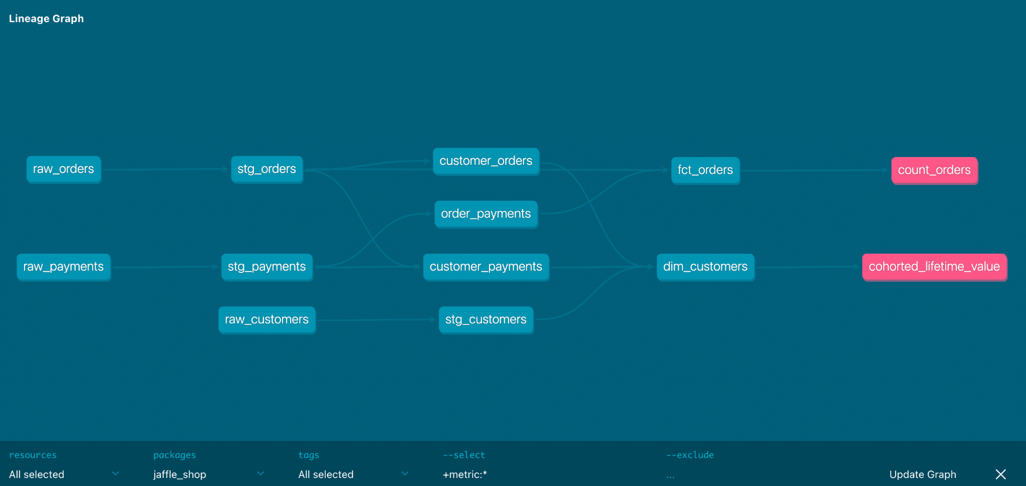
Directed Acyclic Graph
aka show me the order of operations
Source: getdbt.com

Slide 48
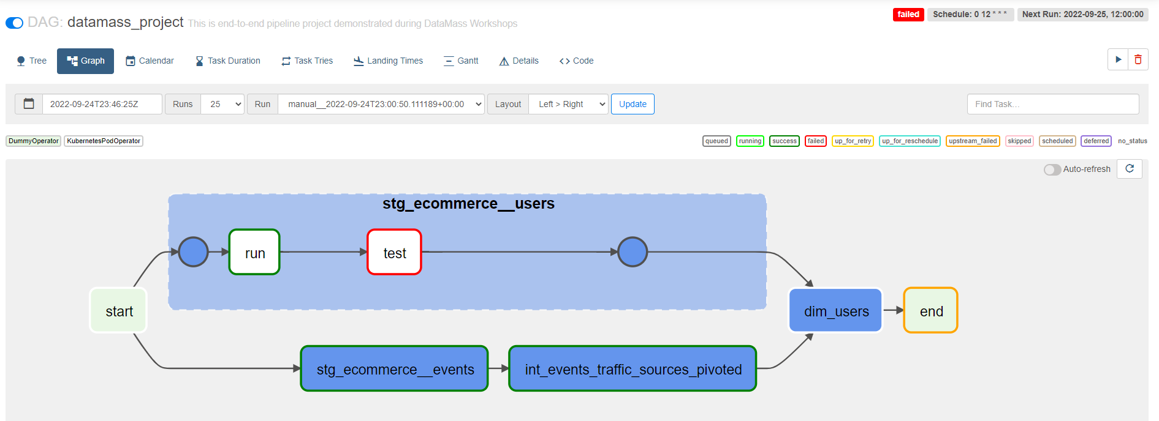
Apache Airflow as a workflow scheduler
Source: getdbt.com

Slide 49
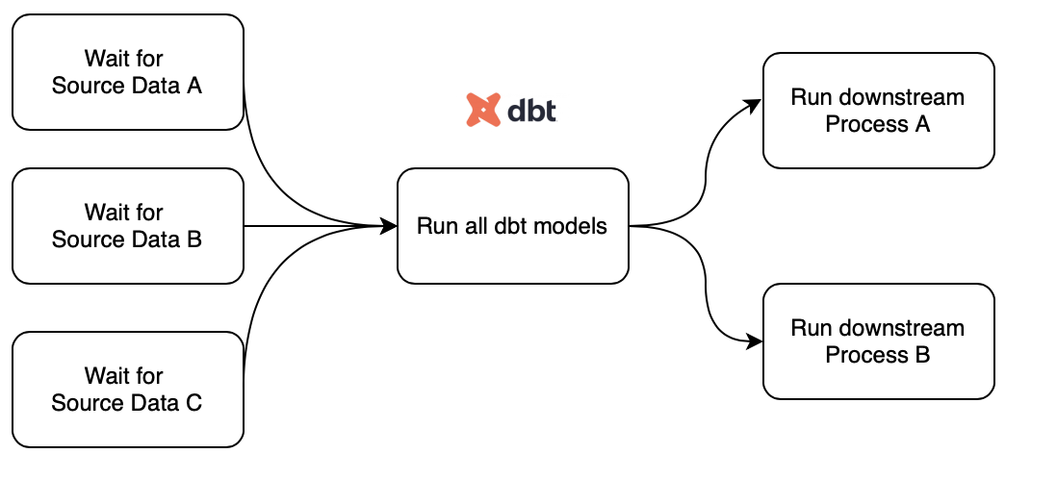
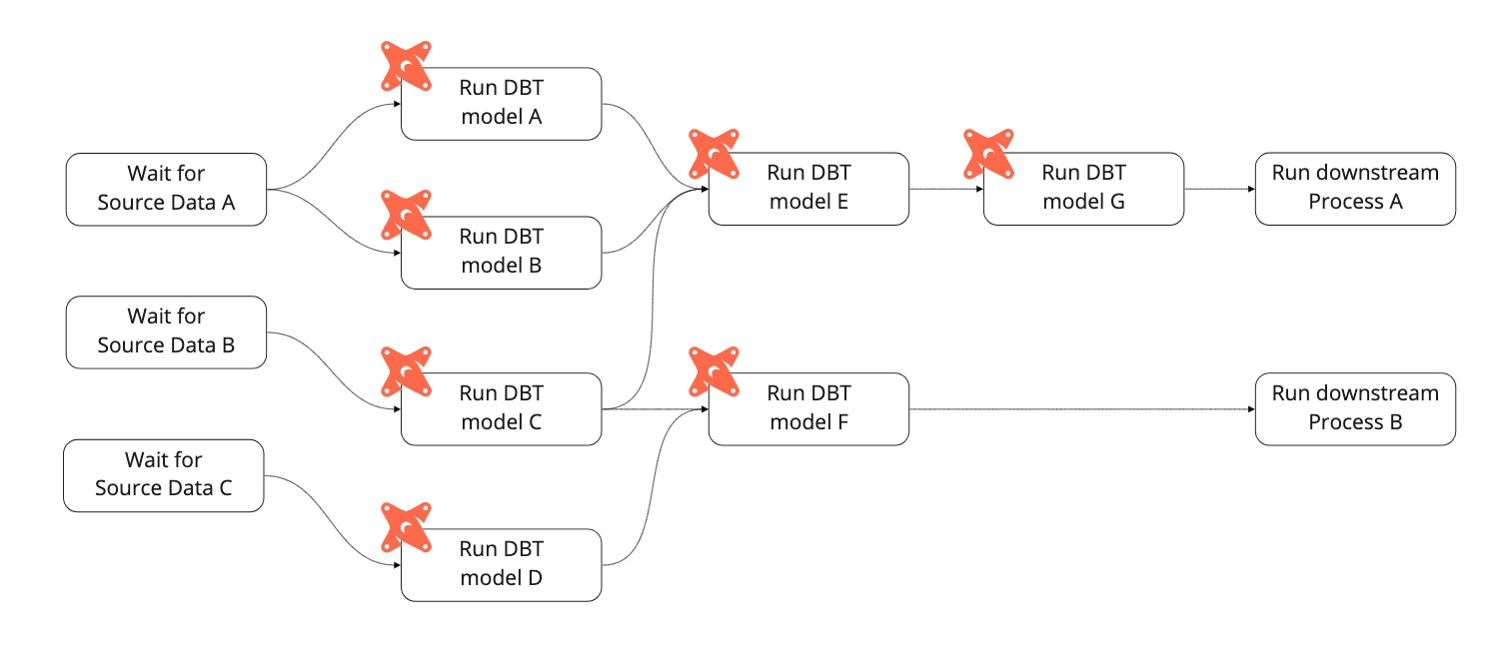
Apache Airflow as a workflow scheduler
dbt and Airflow integrations are very common
run jobs on a cron schedule
view logs
configure error notifications ( Slack)
you can orchestrate your dbt jobs to wait for data sources
Notes:
Dbt and Airflow integrations are commonly used.
This is because dbt itself does not have option for orchestrating other tasks than those performed within SQL transformations.
Airflow will run jobs on a cron schedule and include operators that enable waiting for non-dbt jobs to complete - ie. for jobs related to source data ingestion.
Finally we can set up how we would like to be informed about jobs failures - in example by configuring slack notifications

Slide 50
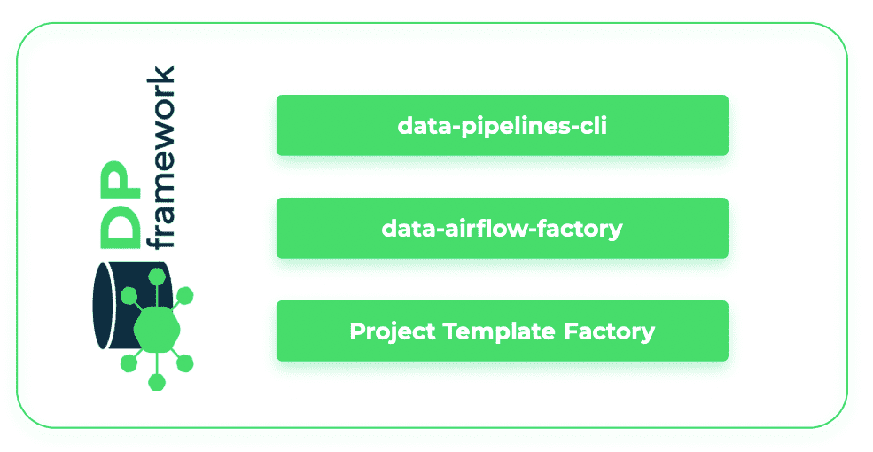
Apache Airflow as a workflow scheduler
dbt-airflow-factory is a library for parsing dbt manifest files and building Airflow DAG
The library is expected to be used inside an Airflow environment with a Kubernetes image referencing dbt
Although the tools was created by GetInData and are used in their project it is open-sourced and everyone is welcome to use and contribute to make it better and even more useful
dbt-airflow-factory
Notes:
In our platform, integration of Airflow and dbt is possible thanks to data-airflow-factory library.

Slide 51
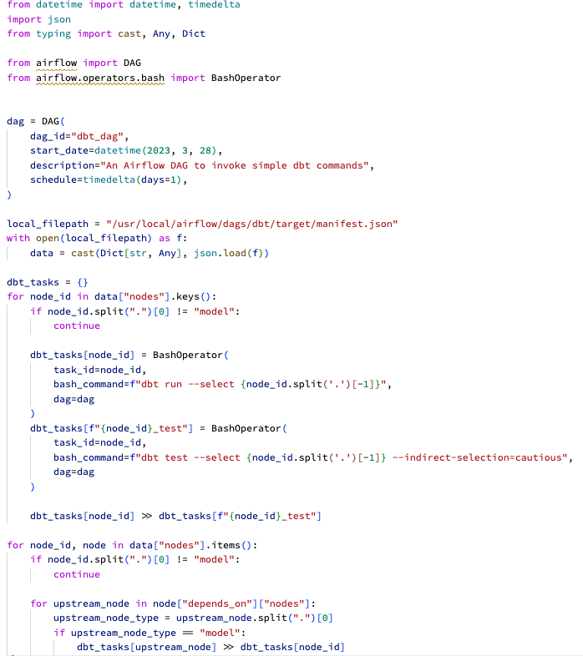
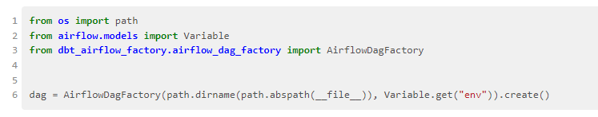
Apache Airflow as a workflow scheduler

Slide 52
CI/CD
Analytics Engineer’s perspective
git commit
git push
* MAGIC *
Dev schema’s models running in the cloud
Accept Pull (Merge) Request
* MAGIC *
Production schema’s models running in the cloud

Slide 53
CI/CD
Data Engineer’s perspective
Run dbt compile, prepare a Docker image with manifest.json and Airflow DAG
Push Docker image to Docker registry
Run DataHub ingestion
Upload DAG to a cloud bucket (GCS, S3) for Airflow (Composer) to pick it up
git commit
git push
Dev schema’s models running in the cloud
Accept Pull (Merge) Request
Production schema’s models running in the cloud

Slide 54
CI/CD
Data Engineer’s perspective
Run dbt compile, prepare a Docker image with manifest.json and Airflow DAG
Push Docker image to Docker registry
Run DataHub ingestion
Upload DAG to a cloud bucket (GCS, S3) for Airflow (Composer) to pick it up
git commit
git push
Dev schema’s models running in the cloud
Accept Pull (Merge) Request
Production schema’s models running in the cloud
dp compile
dp deploy

Slide 55
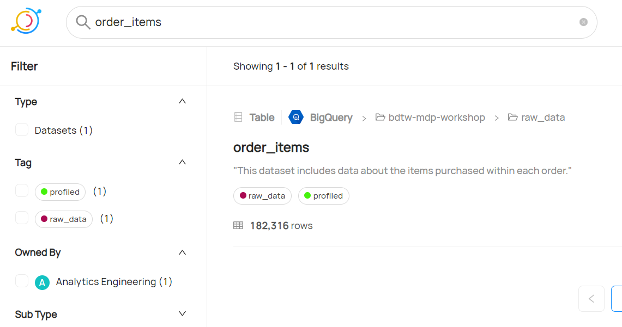
Data Catalog - about
Single source of knowledge about your data
“Google” for your data assets
Where’s my data?
What’s it’s provenance and usage?
Who’s the data owner?
What’s the quality of my data?
Metadata platform that enables data discovery, data observability and federated governance
Metadata is automatically refreshed by data pipelines and CI/CD processes
Notes:
Read the slide
When someone needs to find information like “what kind of table should i choose when i want to analyse that or that” or what are definitions of KPIs we use, Data Catalog is the way

Slide 56
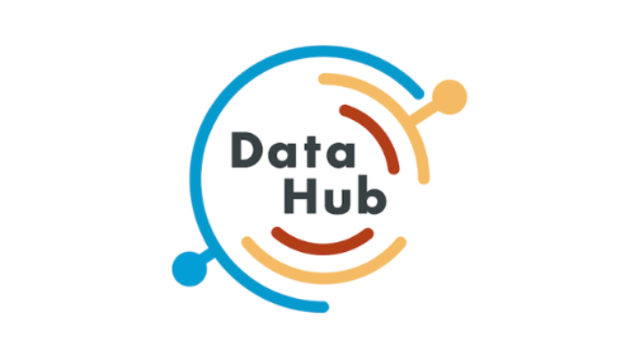
Data Catalog - features
Single source of knowledge about your data
Data search
Query history
Usage statistics
Data definition
Data documentation
Data lineage
Data profiling
Data quality
Business glossary
Data classification
Data ownership
Access control

Slide 57
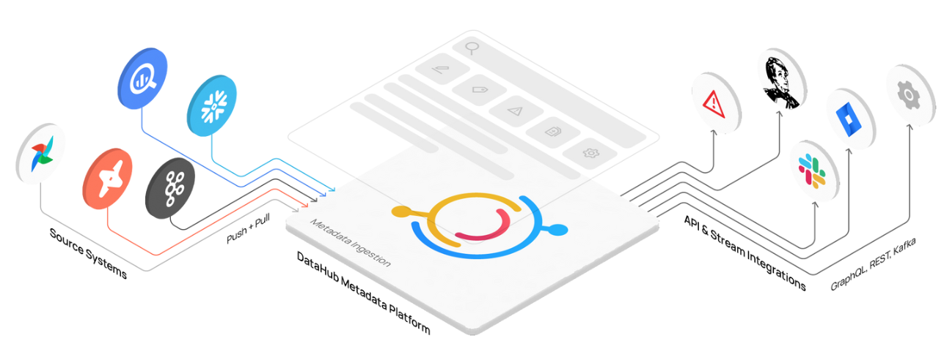
Data Catalog
Single source of knowledge about your data
DataHub: demo
Notes:
For couple of minutes I will dive in the our instance of DataHub and demonstrate some of the cool things.

Slide 58
Data Catalog
Single source of knowledge about your data
DataHub access:
User name & Password: ->
check on Teams channel

Slide 59
Advanced concepts of dbt
Core dbt configuration
profiles.yml
configuring your environments (local, DEV, PROD etc)
dbt_project.yml
Specify operations/metaconfig. Every dbt project has one
specific dbt object .yml files
Each dbt object can have its config done in separate file or it all can be grouped in schema.yml files in respective directories
Covered by MDP
Flexible set-up by MDP
User-defined objects
Notes:
Ok, so lets go back to dbt.
We havent talked much about project configuration and i think this is the time to do it
So in dbt we have thre general levels of configuration -
Profiles, where we define connection between the dbt project and the warehouse (with distinction between local dev prod environments)
In dbt_project.yml we store configuration specific for a projects. Every model, source, macro or whatever dbt entity we can think of inherits configuration and rules store there
Every project has one.
And finally there are specificy amls that we can add to any dbt entity. Config described in models SQL statement or specific yaml has higher priority that the one stored in dbt_project.

Slide 60
Advanced concepts of dbt
Model materialization
Table
Model deployed as table in DWH, recalculating on every dbt run
View
Model deployed as view in DWH, recreating on every dbt run
Ephemeral
Model deployed is NOT deployed in DWH but it’s transferred to downstream SELECT statements in form of CTE
Incremental
Model deployed as table, appending new records if detected per every dbt run
Snapshot
deployed as table, appending new records when there has been a change in existing data, executed in separate run
Notes:
I talked a bit about that in dbt there are couple of materialization types for models
Let’s take a look at them now

Slide 61
Advanced concepts of dbt
Structuring the project
Raw
Staging
Intermediate
Data Mart
dbt sources
no transformations allowed
tests allowed
dbt does not materialize sources
sources =/= models
“Engineering” layer
sublayers: data sources
base and staging models
Initial cleaning & transformations
applying column naming conventions
concatenating
splitting
filtering
applying simple formulas
formatting
JOINs- not recommended
aggregations - strongly not recommended
tests recommended
docs recommended
“Transition” layer
sublayers: business teams
advanced transformations
pivoting
aggregations
JOINs
applying advanced business logic
advanced formulas and functions
tests recommended
docs recommended
“Business” layer
sublayers: business teams
final JOINs
final aggregations
final filtering
quality checked (tests are obligatory)
documentation is obligatory (detailed description for columns, tables, tests, exposures etc)
Snapshots
SCD-2
can serve as a pre-staging layer
JOINs - strongly not recommended
aggregations - strongly not recommended
Notes:
Ok, now, This is a very important part of every dbt project - project structuring
The project structure is an abstract, according to which we divide our transformation models into different groups.
These groups then will be manifested in data warehouse as structurized datasets.
So let’s roughly get through the layer concept presented here
Raw layer is where we gather information about our sources, here there are no transformation allowed, we can put tests and documentation. The purpose of this layer is obvious - as in dbt we do not reference any object that are not defined by dbt.
The staging layer can be described as an engineering-like layer.
This is where we prepare our data, clean it, convert shapes etc. and standardize according to our naming policies.
It is not place for aggregations or joins. We can and should put test and descriptions here.
If we require sublayer, it is recommended to user names of raw datasets in the data warehouse.
As an example - ecommerce , google analytics etc.
In the intermediate layer we introduce transition models -
here our SQL queries should introduce advanced transformations for pivoting, aggregations, multiple joins, application of advanced business logic and so on.
As everywhere else, it is recommended to test and document models here.
Finally, the data mart - this is a place in data warehouse where most of data user will have direct access to.
For the previous layers this access can be restricted.
Data stored in data mart needs to be of highest quality, so it needs to be tested and documented.
From the model perspective - here we perform final joins and aggregations, we avoid complex transformations, which should be completed in the intermediate layer.

Slide 62
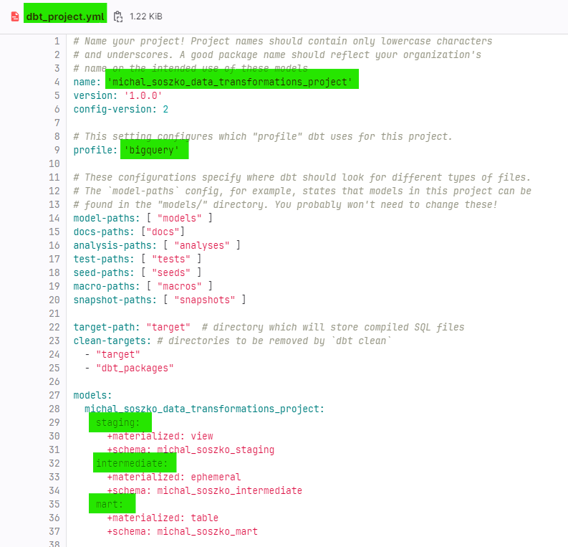
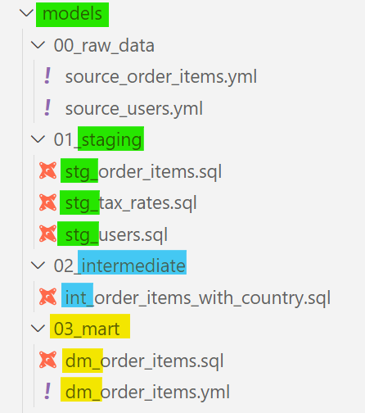
Advanced concepts of dbt
Structuring the project
Raw
Snapshots
Staging
Intermediate
Data Mart

Slide 63
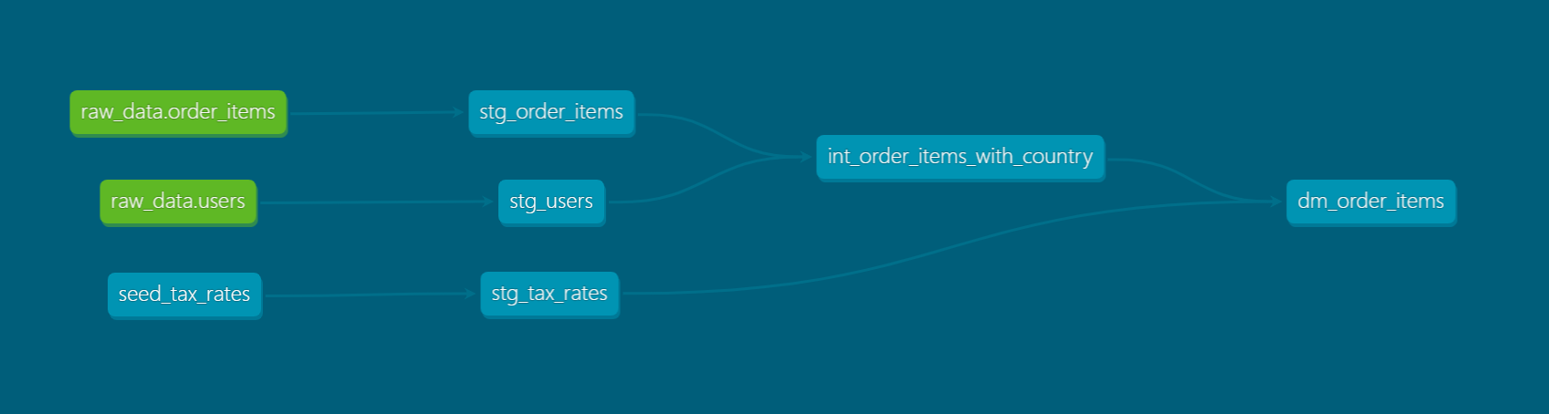
Advanced concepts of dbt
Structuring the project
Raw
Staging
Intermediate
Data Mart
dbt sources
no transformations allowed
tests allowed
dbt does not materialize sources
sources =/= models
“Engineering” layer
sublayers: data sources
base and staging models
Initial cleaning & transformations
applying column naming conventions
concatenating
splitting
filtering
applying simple formulas
formatting
JOINs- not recommended
aggregations - strongly not recommended
tests recommended
docs recommended
“Transition” layer
sublayers: business teams
advanced transformations
pivoting
aggregations
JOINs
applying advanced business logic
advanced formulas and functions
tests recommended
docs recommended
“Business” layer
sublayers: business teams
final JOINs
final aggregations
final filtering
quality checked (tests are obligatory)
documentation is obligatory (detailed description for columns, tables, tests, exposures etc)
Snapshots
SCD-2
can serve as a pre-staging layer
JOINs - strongly not recommended
aggregations - strongly not recommended

Slide 64
Advanced concepts of dbt
Naming convention
staging_<dataset>__ <table>
stg_<dataset>__<table>
stg_<table>
base_<dataset>__ <table>
base_<table>
Staging
source_<dataset>__ <table>
src_<dataset>__<table>
src_<table>
Raw
Intermediate
int_<descriptive_name>
example: int_active_users_with_mapped_payments_agg_daily
Snapshots
snapshot_<dataset>__<table>
snapshot_<table>
dm_<name>
mart_<name>
dm_<business_unit>__<name>
mart_<business_unit>__<name>
<name>
<business_unit>_<name>
dm_<short_descriptive_name>
mart_<short_descriptive_name>
examples:
dm_users, mart_active_subscriptions_aggd,
mart_marketing__campaigns
Data Mart

Slide 65

DEMO:
Simple dbt pipeline scheduled with Airflow
Connection to BI Tools

Slide 66
hands-on exercises:
Open Session_3.md and start reforging your dbt pipeline into well structured project and then use GitLab to publish your work on prod.

Slide 67
Session 4 starts at 15:30

Slide 68

Q&A

Slide 69
Let’s summarize
Concept of MDP
Core concepts of dbt
Created dbt project using MDP environment
Created simple data transformation pipeline locally
Applied data quality checks & docs
Refined project structure
Published data pipeline to “prod”
Scheduled run & prepared tables for analysis

Slide 70

Wrap up
Thank you!
Contact us!
https://getindata.com/estimate
Our blog
https://getindata.com/blog
Our podcast
Radio DaTa
Notes:
You can also find us on all popular social media and see you at the conference tomorrow - look for our booth!

